Slide 1

MACHINE
INTELLIGENCE
BAYESIAN LEARNING
K.S.Srinivas
Department of Computer Science and Engineering

Slide 2

Machine Intelligence
Unit III
Bayesian Learning – Bayes Theorem and Concept Learning
Srinivas K .S
Department of Computer Science
Notes:
S

Slide 3
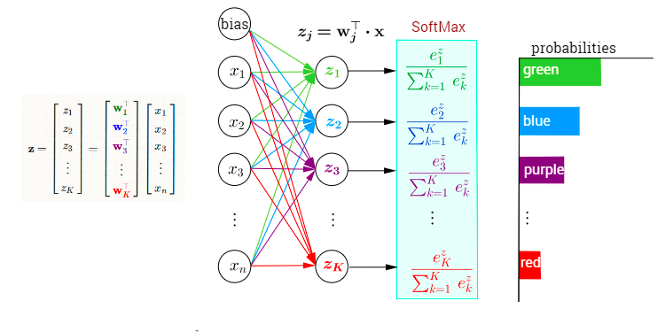
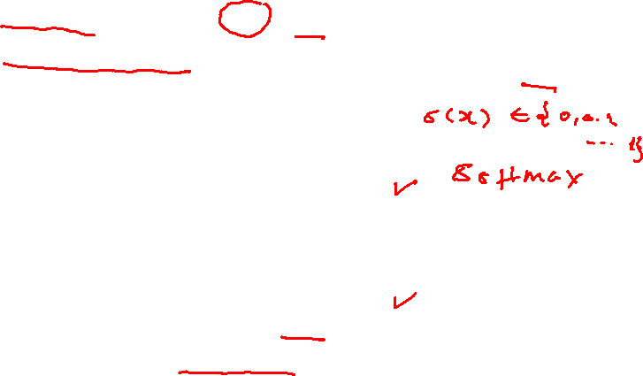
Probabilistic Learning
Much of our dear friend the neural network outputs values are in terms of probability A sigmoid function is not a probability density function (PDF), as it integrates to infinity. However, it corresponds to the cumulative probability function of the logistic distribution. Given that Sigmoid values lie in the interval [0,1], you can still interpret them as a confidence index. SoftMax function outputs a vector that represents the probability distributions of a list of potential outcomes
Notes:
Slide 2 starts

Slide 4

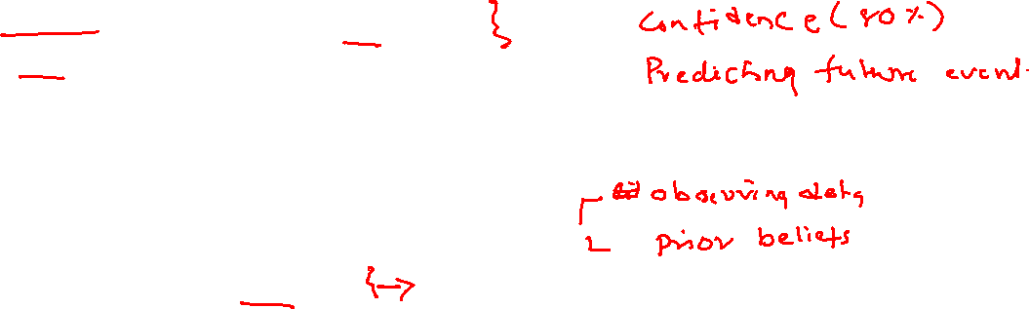
Probabilistic Learning
Prof Winston Patrick often describes Artificial Intelligence as computational statistics You will see that thru the class that our intuitive error function for neural networks in indeed probabilistic We will see in this class how probability is used for modelling concepts Bayesian Probability is the notion of probability about partial beliefs Bayesian Estimation calculates the validity of a proposition
Probability deals with predicting the likelihood of future events
Notes:
Slide 2 starts

Slide 5




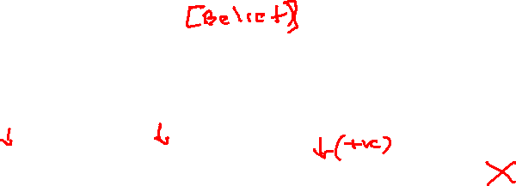
Probabilistic Learning
Calculating the validity of a proposition is based on Prior Estimates New Evidence Based on this is the posterior estimation done This forms that heart of Bayes Theorem but lets step back Psychological research has shown that people can learn concepts from positive examples alone (
We Learn a concept from +example alone
Notes:
Slide 2 starts

Slide 6
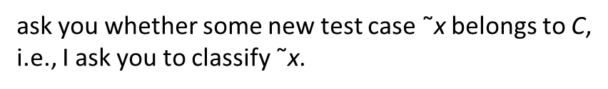
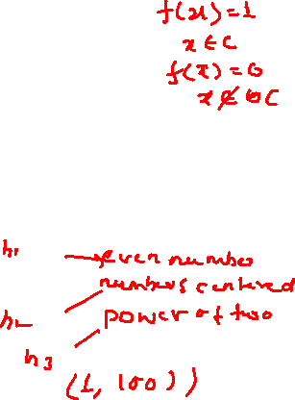
Probabilistic Learning
We can think of learning the meaning of a word as equivalent to concept learning, which in turn is equivalent to binary classification. To see this, define f(x) = 1 if x is an example of the concept C, and f(x) = 0 otherwise Then the goal is to learn the indicator function f, which just defines which elements are in the set C. I am thinking of some arithmetical concept, such as: Prime numbers Numbers between 1 and 10 Even numbers I give you a series of randomly chosen positive examples from the chosen class
Notes:
Slide 2 starts

Slide 7
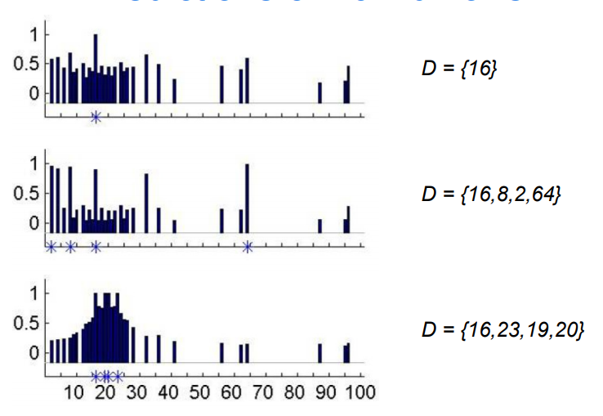
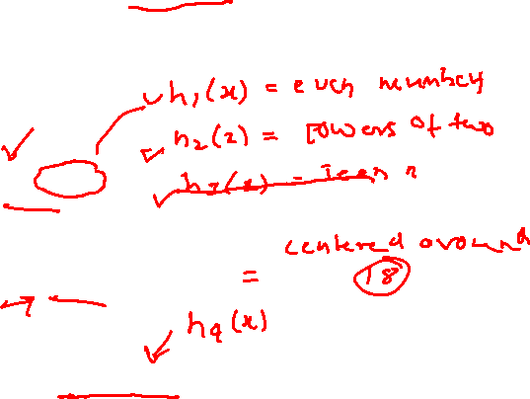
Probabilistic Learning
Suppose the data set contains all integers from 1 to 100 We are asked to learn which are the other numbers similar to this concept
Notes:
Slide 2 starts

Slide 8

Probabilistic Learning
Thus some numbers are more likely than others We can represent this as a probability distribution, p(˜x|D), which is the probability that ˜x ∈ C given the data D for any ˜x ∈ {1, . . . , 100}. This is called the posterior predictive distribution.
Notes:
Slide 2 starts

Slide 9
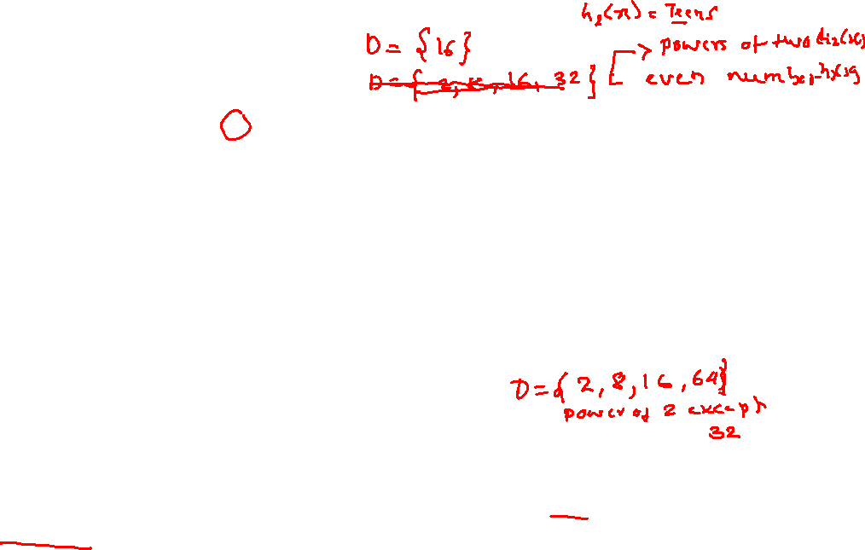
Probabilistic Learning
Now suppose I tell you that 8, 2 and 64 are also positive examples. Now you may guess that the hidden concept is “powers of two”. This is an example of induction How can we explain this behavior and emulate it in a machine? The classic approach to induction is to suppose we have a hypothesis space of concepts, H, such as: odd numbers, even numbers, all numbers between 1 and 100, powers of two. The subset of H that is consistent with the data D is called the version space. As we see more examples, the version space shrinks and we become increasingly certain about the concept However, the version space is not the whole story. After seeing D = {16}, there are many consistent rules; how do you combine them to predict if ˜x ∈ C? Also, after seeing D ={16, 8, 2, 64}, why did you choose the rule “powers of two” and not, say, “all even numbers”, or “powers of two except for 32”, both of which are equally consistent with the evidence?
Notes:
Slide 2 starts

Slide 10

Likelihood
However, the version space is not the whole story. After seeing D = {16}, there are many consistent rules; how do you combine them to predict if ˜x ∈ C? Also, after seeing D ={16, 8, 2, 64}, why did you choose the rule “powers of two” and not, say, “all even numbers”, or “powers of two except for 32”, both of which are equally consistent with the evidence?
Why would you say H(power of 2 ) instead of H(even number)?
Lets extend the set to all integers from 1…100?
How many powers of 2 do we have - 6 and even 50
Then p(D|htwo) = 1/6, since there are only 6 powers
of two less than 100, but p(D|heven) = 1/50, since there are 50 even numbers.
So the likelihood that h = htwo is higher than if h = heven
Notes:
Slide 2 starts

Slide 11
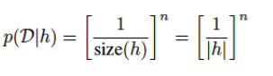
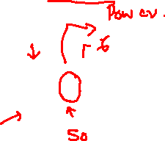
Likelihood
Likelihood:
• Assume examples are sampled uniformly at random from all numbers that are consistent with the hypothesis
• Size principle: Favors smallest consistent hypotheses
Notes:
Slide 2 starts

Slide 12

Prior
Prior is the mechanism by which background knowledge can be brought to bear on a problem.
Suppose you were told 1400, 1200, 1600, 1800 are the arithmetic output of some other numbers, would you believe 1100 to be belonging to that same concept or would you say 1183 belongs to the same concept
Based on prior experience, some hypotheses are more probable (natural) than others
Notes:
Slide 2 starts

Slide 13
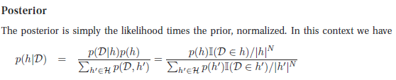
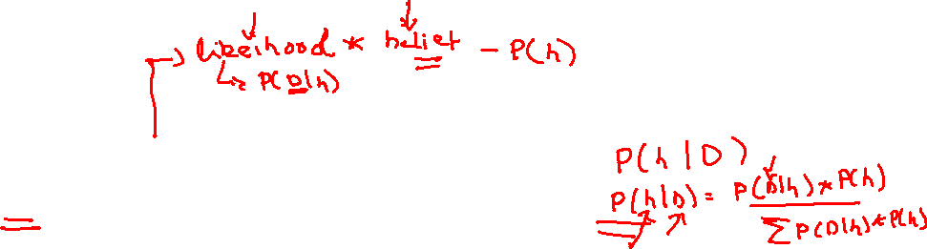
Posterior
where I(D ∈ h) is 1 iff (iff and only if) all the data are in the extension of the hypothesis
h
That’s Bayes theorem for you
Notes:
Slide 2 starts

Slide 14
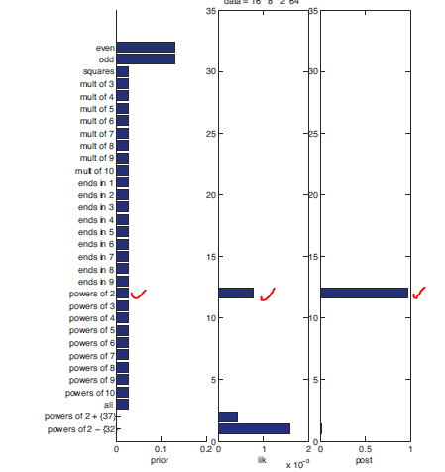

Posterior
We see that the posterior is a combination of prior and likelihood. In the case of most of the concepts, the prior is uniform, so the posterior is proportional to the likelihood.
Notes:
Slide 2 starts

Slide 15

Posterior
In general, when we have enough data, the posterior p(h|D) becomes peaked on a single concept, namely the MAP estimate, i.e.,
p(h|D) → δˆhMAP (h)
where ˆhMAP = argmaxh p(h|D) is the posterior mode, and where δ is the Dirac measure
defined by
δx(A) =
1 if x ∈ A
0 if x ∈ A
Notes:
Slide 2 starts

Slide 16
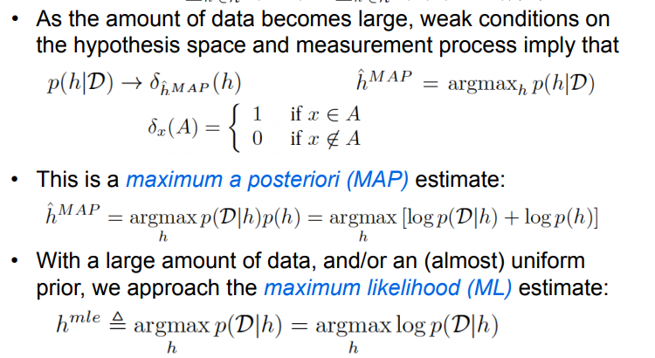

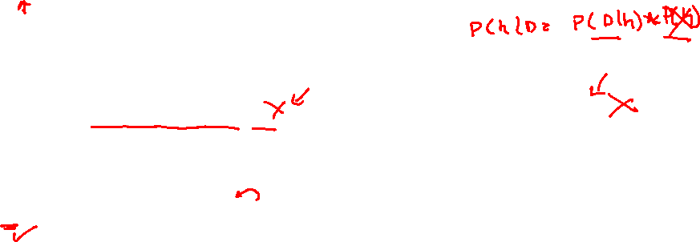
Posterior
Notes:
Slide 2 starts

Slide 17
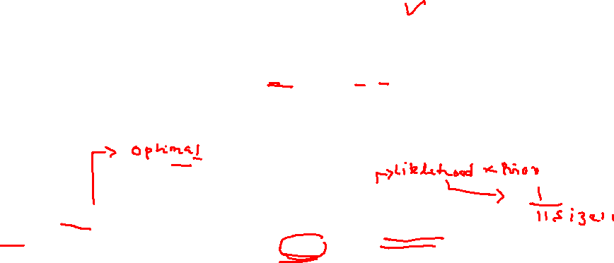
MAP (“maximum a posteriori”) Learning
Bayes rule:
Goal of learning: Find maximum a posteriori hypothesis h_{MAP}:
This is the optimal hypothesis in the sense that no other hypothesis is more likely.
* note that P(D) can be dropped, because it is a constant independent of h
Notes:
Now we can conveniently simplify Equation by dropping the denominator P(d). This is possible because we will be computing P(d|h)P(h) for each possible hypothesis.
But P(d) doesn’t change for each hypothesis
Hence by using Bayes theorem, we can identify the MAP hypothesis from the posterior probability of each “Candidate “ hypothesis.

Slide 18
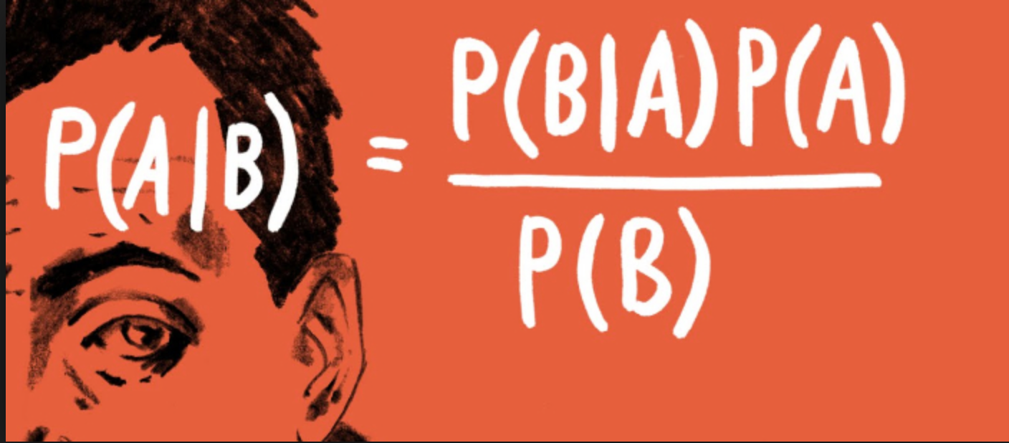
Recap to Bayes theorem
Bayes Theorem provides a principled way for calculating a conditional probability.
It provides to build a probabilistic model to describe the relationship between data (D) and a hypothesis (h).

Slide 19
Recap to Bayes theorem
P( A|B) = P(B|A) P(A) / P(B).
Bayes Theorem provides a probabilistic model to describe the relationship between data (D) and a hypothesis (h); for example:
It is rewritten as
P(h|D) = P(D|h) P(h) /P(D)
P(h|D): Posterior probability of the hypothesis (the thing we want to calculate).
P(h): Prior probability of the hypothesis.

Slide 20
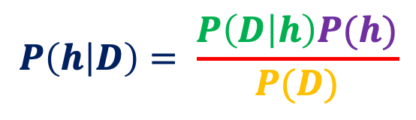
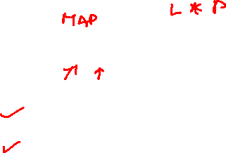
Bayes Theorem for Modeling Hypotheses
In the context of classifiers, hypothesis h and training data D are related as
$$P\left(h | D\right)= \frac{P\left(D | h\right)P(h)}{P(D)}$$
𝑃(h)–prior probability of hypothesis h
𝑃(D)–prior probability of training data D
𝑃 (h|D) – posterior probability of h given D
𝑃 (D|h) – Likelihood: probability of D given h

Slide 21
Application of Bayes theorem
To calculate the most probable hypothesis
P(h|D) = P(D|h) P(h) /P(D)
Bayes theorem provides a way to calculate the probability of a hypothesis based on its prior probability, the probabilities of observing various data given the hypothesis, and the observed data itself.

Slide 22
Best hypothesis ≈ most probable hypothesis
The goal of Bayesian Learning:
To locate a hypothesis that best explains the observed data.
Notes:
The intuition of Bayesian classification is to use Bayes’ rule into other probabilities that have some useful properties.
Let us discuss on this in the next slide

Slide 23
MAP Learning: Applications
Fitting models like linear regression for predicting a numerical value, and logistic regression for binary classification can be framed and solved under the MAP probabilistic framework.
This provides an alternative to the more common maximum likelihood estimation (MLE) framework.

Slide 24


ML Hypothesis
In some cases, if every hypothesis in H is equally probable a priori i.e., P(h_{i}) = P(h_{j}) for all h_{i} and h_{j} in H
$$h_{ML}= \underset{h ε H}{argmax}{P(D|h)}$$
h_{ML} is called the “maximum likelihood hypothesis”.
P(D|h) – the likelihood of the data D given h

Slide 25


Summary : Classes of Hypotheses
MAP Hypothesis
Bayesian Recipe for learning
$$h_{MAP}= \underset{h ε H}{argmax}{P\left(D | h\right)P(h)}$$
2. ML Hypotheis
$$h_{ML}= \underset{h ε H}{argmax}{P(D|h)}$$
When h_{MAP} = h_{ML}?
If P(h_{i}) = P(h_{j}) , ∀ i,j then. h_{MAP} = h_{ML}

Slide 26
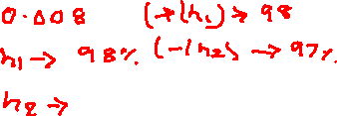
Example: Does patient have cancer or not?
A patient takes a test for cancer. The test has two outcomes: positive and negative. It is known that if the patient has cancer, the test is positive 98% of the time. If the patient does not have cancer, the test is negative 97% of the time. It is also known that 0.008 of the population has cancer.
The patient’s test is positive.
Which is more likely: Should we diagnose a patient whose lab result is positive as having cancer?

Slide 27
Does patient have cancer or not?
Initial belief :
It is also known that 0.008 of the population has cancer.
P(cancer) = P(h1) = 0.008
P(¬cancer) = P(h2) =0.992
The data given in this problem is represented in table form as
Test/ Actual | Cancer | ¬Cancer
+ | 0.98 | 0.03
- | 0.02 | 0.97

Slide 28
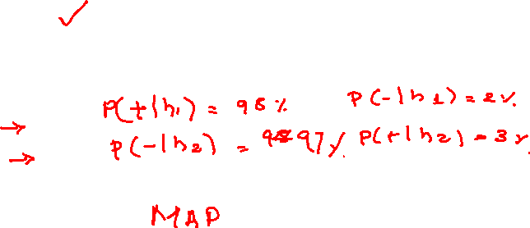
Problem Summary
Hypothesis space: Outcome
h₁ = Patient has cancer D ={+,-}
h₂ = Patient does not have cancer
Prior Probability: 0.008 of the population has cancer. Thus
P(cancer) = P(h₁) = 0.008
P(¬cancer) =P(h₂) = 0.992
Conditional probability:
P(+ | h₁) = 0.98, P(− | h₁) = 0.02
P(+ | h₂) = 0.03, P(− | h₂) = 0.97
Posterior knowledge:
Blood test is + for this patient.

Slide 29
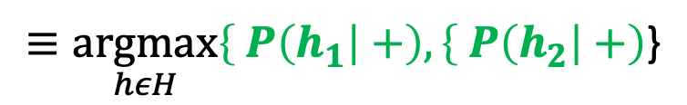
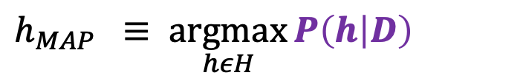

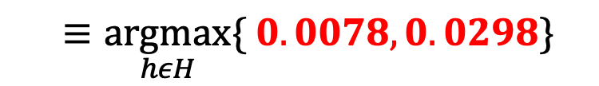
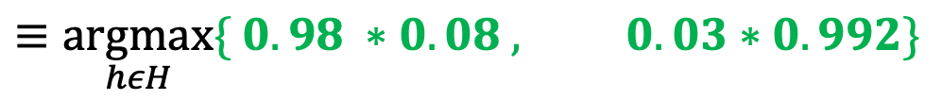
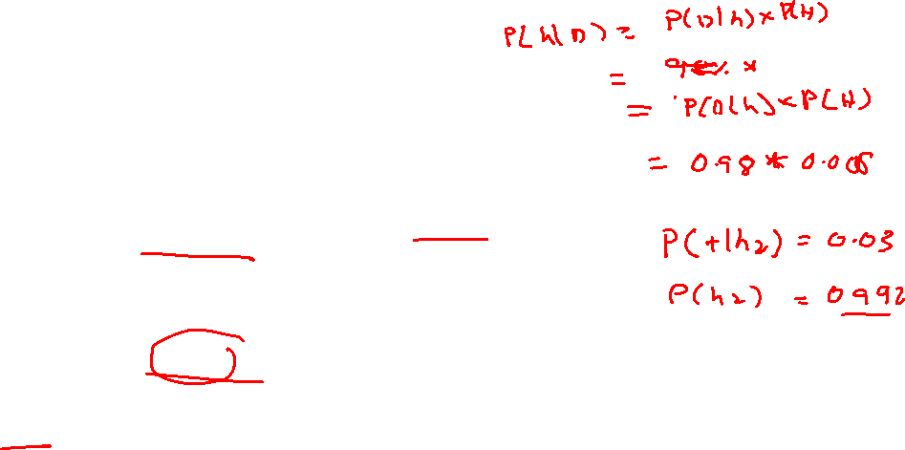
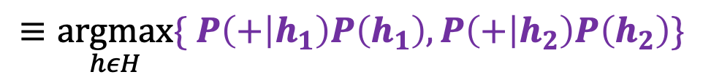
What is the probability that the patient indeed has cancer?
$h_{MAP }$ $≡ \underset{hεH}{argmax}{P\left(h | D\right)}$
$≡\underset{hεH}{argmax}\left\{ P\left(h_{1}\right|+\right),\left\{ P\left(h_{2}\right|+\right)$}
$$≡\underset{hεH}{argmax}{\{ P\left(+ | h_{1}\right)P\left(h_{1}\right),P\left(+ | h_{2}\right)P\left(h_{2}\right)}\}$$
$$≡\underset{hεH}{argmax}{\{ 0.98 ∗0.08 , 0.03∗0.992\}}$$
$$≡\underset{hεH}{argmax}{\{ 0.0078, 0.0298\}}$$
$h_{MAP }$ $≡ h_{2}$
(¬ cancer)
The most probable hypothesis is h2(The patient does not have cancer)

Slide 30
Normalization of probabilities
The exact posterior probabilities can be determined by normalizing the above properties to 1
0.0078
0.0078 + 0.0298
P(h₁ |+) =
= 0.21
0.0298
0.0078 + 0.0298
P(h₂|+) =
= 0.79
⇒ the result of Bayesian inference depends strongly on the prior probabilities, which must be available in order to apply the method directly

Slide 31
THANK YOU
Srinivas K.S
Department of Computer Science
srinivasks@pes.edu

Slide 32
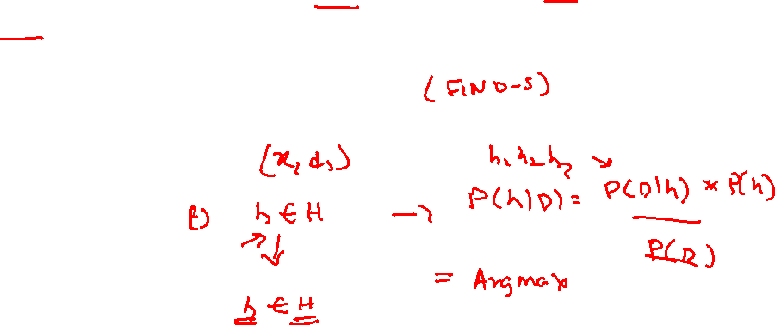
Bayes Theorem and Concept Learning
What is the relationship between Bayes theorem and the problem of concept learning?
It can be used for designing a straightforward learning algorithm called
Brute-Force MAP LEARNING algorithm

Slide 33
Brute-Force MAP Learning Algorithm
The MAP hypothesis output is used to design a simple learning algorithm called “Brute force learning algorithm”

Slide 34
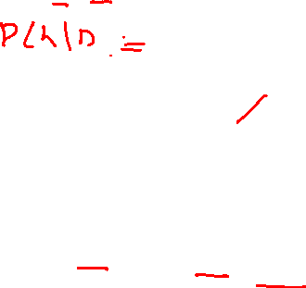
Brute-Force MAP Learning Algorithm
For each hypothesis h ∈ H, calculate the posterior probability
P(D|h)P(h) ………….(1)
P(D)
Output hypothesis h_{MAP} with the highest posterior probability
h_{MAP} = argmax P(h|D)…………(2)
h∈H

Slide 35
Brute-Force MAP Learning Algorithm
This brute-force MAP learning algorithm may be computationally infeasible, as it requires applying the Bayes theorem to all h ∈ H.
However, this is still useful as a standard against which other concept learning approaches may be judged.

Slide 36
Relation to Concept learning
Consider our usual concept learning task
instance space X, hypothesis space H, training examples D
consider the Find S learning algorithm (outputs most specific hypothesis from the version space V S_{H;D )}
What would Bayes rule produce as the MAP hypothesis ?
Does “Find S” output a MAP hypothesis ?

Slide 37
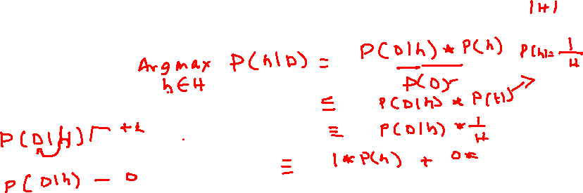
Relation to Concept learning
Assume fixed set of instances <x₁, x₂, ………, x_{m}>
Assume D is the set of classifications D = < c(x₁),…….,c(x_{m})>
Choose P(D|h):

Slide 38
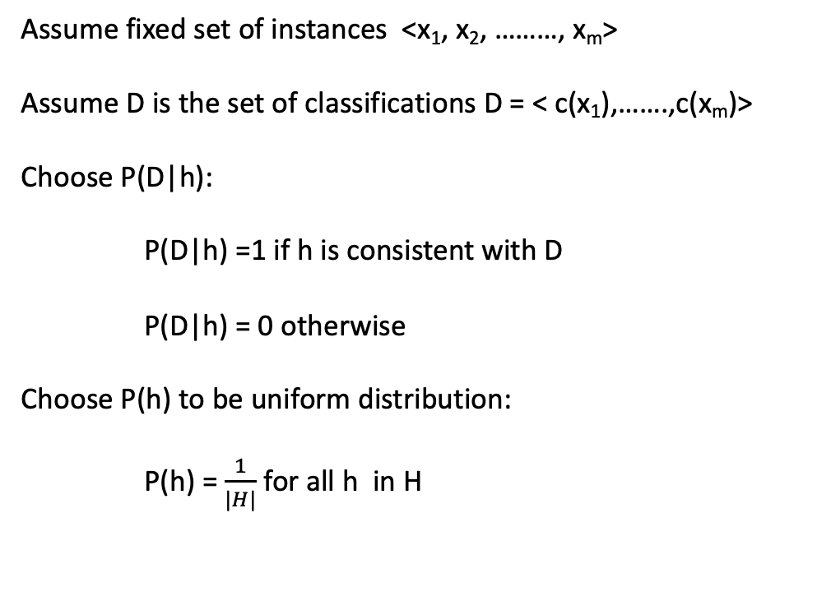
Relation to Concept learning
Assume fixed set of instances <x₁, x₂, ………, x_{m}>
Assume D is the set of classifications D = < c(x₁),…….,c(x_{m})>
Choose P(D|h):
P(D|h) =1 if h is consistent with D
P(D|h) = 0 otherwise
Choose P(h) to be uniform distribution:
P(h) =$\frac{1}{|H|}$ for all h in H

Slide 39
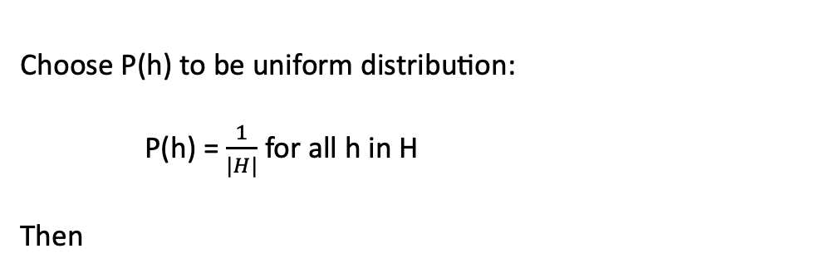
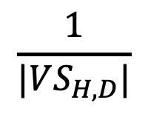
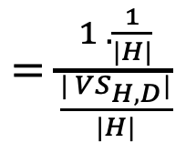
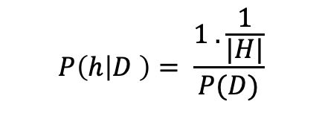
Relation to Concept learning
Choose P(h) to be uniform distribution:
P(h) =$\frac{1}{|H|}$ for all h in H
Then
$$P\left(h | D \right)= \frac{1 . \frac{1}{|H|}}{P(D)}$$
$=\frac{1 . \frac{1}{|H|}}{\frac{| VS_{H,D}|}{|H|}}$
$$\frac{1}{|VS_{H,D}|}$$

Slide 40
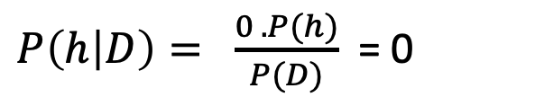
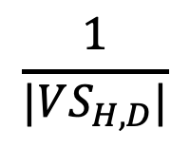
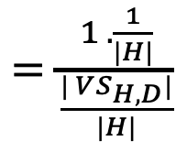
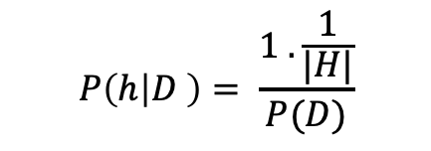
Brute-Force MAP Learning
Therefore, the brute force algorithm can now proceed in two ways.
$P\left(h | D\right)= \frac{0 . P(h)}{P(D)}$ = 0
If h is consistent with training data D
$$P\left(h | D \right)= \frac{1 . \frac{1}{|H|}}{P(D)}$$
$=\frac{1 . \frac{1}{|H|}}{\frac{| VS_{H,D}|}{|H|}}$
$$\frac{1}{|VS_{H,D}|}$$
=
Thus, every consistent hypothesis has posterior probability 1/|VS_{H,D}| and is a MAP hypothesis.

Slide 41
Brute-Force MAP LEARNING
⇒ The sum over all hypotheses of P(h|D) must be one and the number of hypotheses consistent with D is by definition
|VS_{H,D} |.
⇒ this analysis implies that, under these assumptions, each consistent hypothesis is a MAP hypothesis, because for each
consistent hypothesis P(h|D) = |
1
VS_{H,D} |

Slide 42
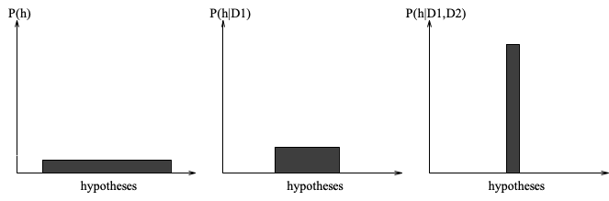
Brute-Force MAP Learning
As data is added, certainty of hypotheses increases.
Figure (a)
Figure (b)
Figure (c)
evolution of probabilities
(a) all hypotheses have the same probability
(b) + (c) as training data accumulates, the posterior probability of inconsistent hypotheses becomes zero while the total probability summing to 1 is shared equally among the remaining consistent hypotheses

Slide 43
Consistent Learners
Every hypothesis consistent with D is a MAP hypothesis, if
uniform probability over H
target function c H deterministic, noise-free data
FindS will output a MAP hypothesis, even though it does not explicitly use probabilities in learning.
Bayesian interpretation of inductive bias : use Bayes theorem, define restrictions on P(h) and P(D| h )

Slide 44
Characterizing Learning Algorithms by Equivalent MAP Learners

Slide 45
References
1. “Machine Learning”, Tom Mitchell, McGraw Hill Education (India), 2013.

Slide 46
Notations used
h (hypothesis): A single hypothesis, e.g. an instance or specific candidate model that maps inputs to outputs and can be evaluated and used to make predictions.
H (hypothesis set): A space of possible hypotheses for mapping inputs to outputs that can be searched, often constrained by the choice of the framing of the problem, the choice of model and the choice of model configuration.
D :

Slide 47
THANK YOU
Srinivas K.S
Department of Computer Science
srinivasks@pes.edu

